Slide 1
Machine Learning for Optic Correction in the LHC
Alejandro Börjesson Carazo
23/04/2023

Slide 2
Summary
Introduction
Results
Error simulation
ML Model evaluation
Conclusion
Backup slides

Slide 3
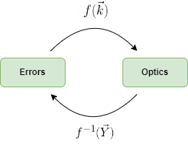
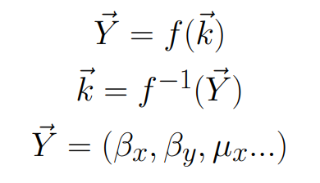
Introduction
Actual methods for quadrupole magnetic error correction consist on knob tuning, response matrix …
Problems, no information on the actual magnet errors
Correcting the optics, but not the actual magnet errors!
Machine learning promises multiple new ways to manage quadrupole errors
The effect of magnet errors on optics can be calculated using simulation software
ML can be used to model the relation between optics and errors regardless on how complex

Slide 4
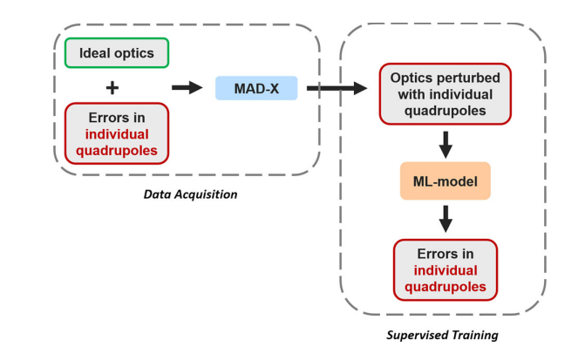

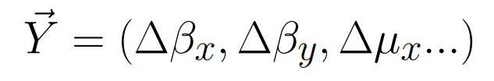
Methods: Data pipeline
Generating random quadrupole strength errors and calculating the corresponding twiss parameters for data generation
Possible improvements to data generation include using MAD-NG or adding noise
Fig 1. Data pipeline

Slide 5
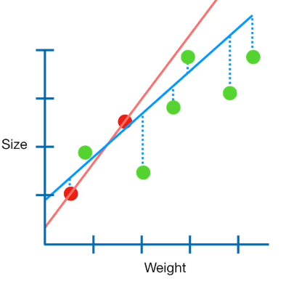
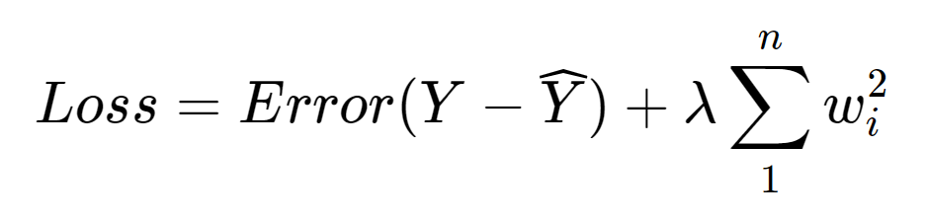
Methods: ML Model
Ridge and Linear Regression:
Least squares regression with L2 regularization
Bagging:
Training using ten different subsets of data and averaging the results.
This methods decreases variance of the model and overfitting
Fig 2. Example Ridge regression

Slide 6
Results: Error Simulation
Elena used 2016 40 CM optics so the whole MADX script had to be updated, repurposing error generation
80k Samples using 2023 30 CM optics, errors seem to be too big for this optics 15% of twiss failed!
80k Samples with 2023 45 CM, in this case 1-2% of twiss fail
All results shown are for 2023 30 CM optics

Slide 7
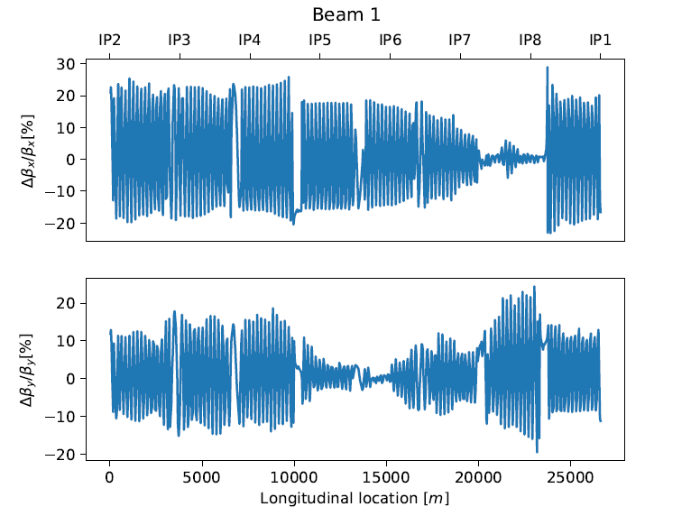
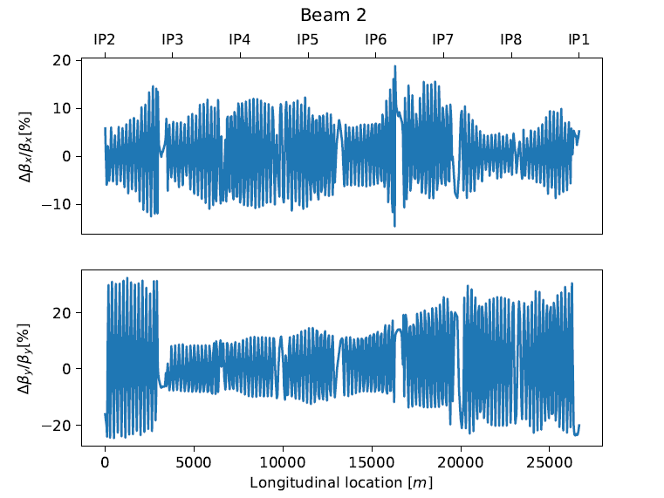
Results: Error Simulation
Fig 3. Example Beta Beating

Slide 8
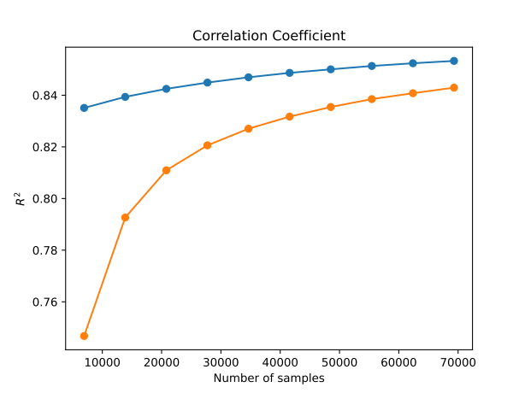
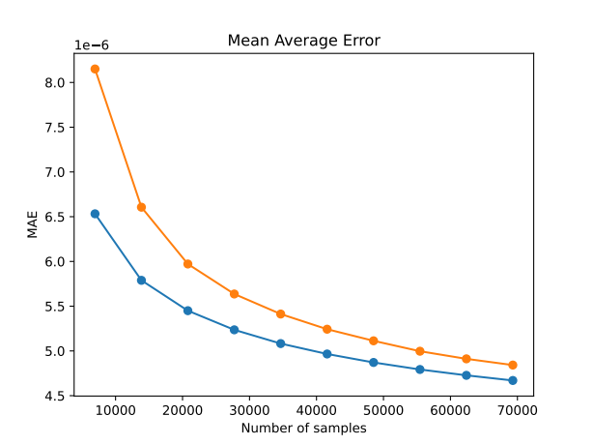
Results: Model Training
Fig 4. Training for different number of samples

Slide 9
Results: Model Training
Decision tree regression: Not worth considering
For 45CM optics results are similar
Algorithm | Correlation Coefficient: R2 | Mean Absolute Error: MAE
Ridge Regression | Train: 0.853 | Train: 4.67e-06
 | Test: 0.843 | Test: 4.83e-06
Linear Regression | Train: 0.888 | Train: 3.45e-06
 | Test: 0.872 | Test: 3.69e-06

Slide 10
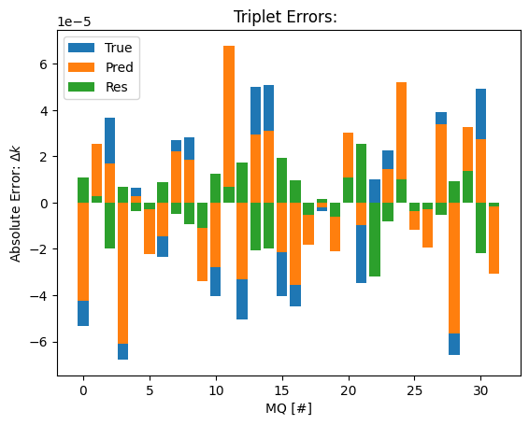
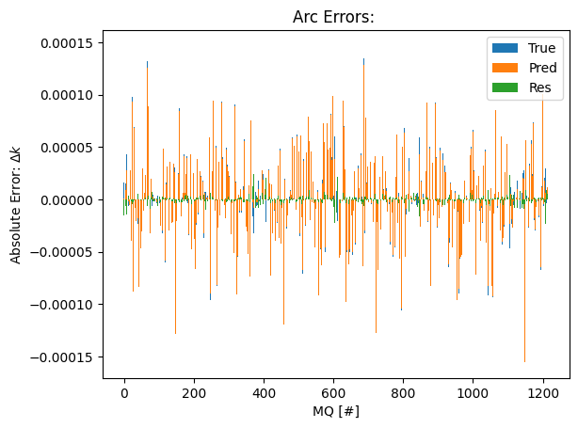
Results: Example prediction
Fig 5. Quadrupole error prediction using linear reg. (random sample)

Slide 11
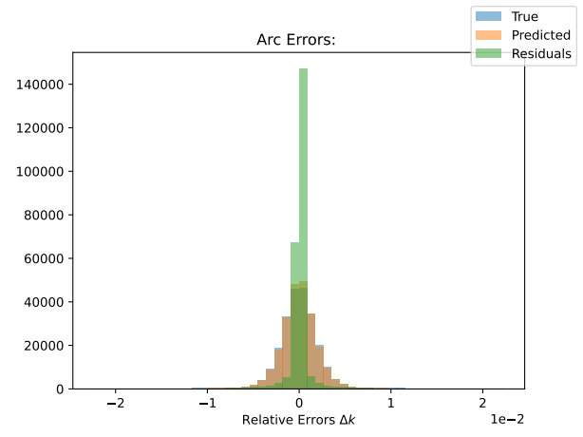
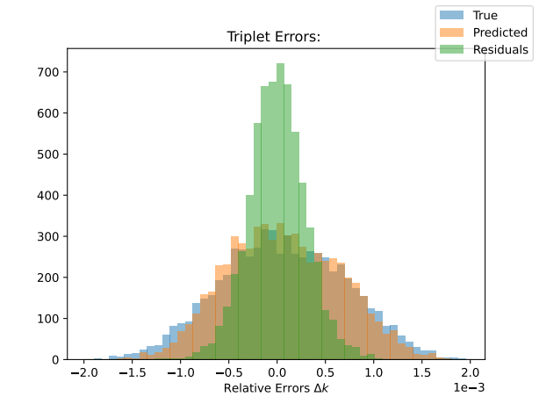
Results: Error Histogram Prediction
Fig 6. Relative error histograms for 200 test samples

Slide 12
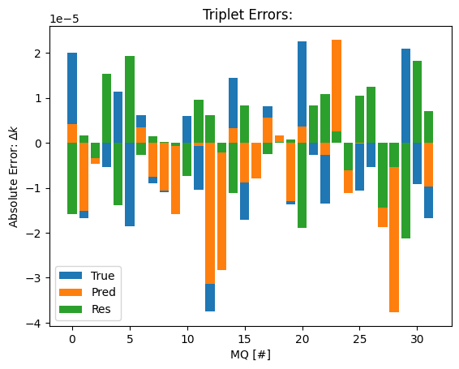
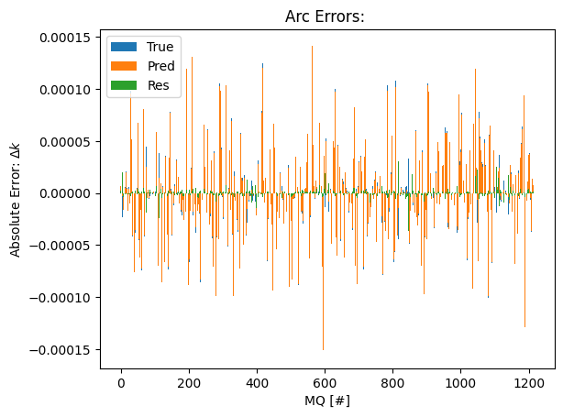
Results: Error Histogram Prediction
Fig 7. Example of worse performing sample (Triplets!)

Slide 13
Results: Performance for different magnets
Unexpected! R2 slightly worse or similar for triplet errors, expected better R2
MAE Is not a great indicator since error generation is different for triplet and arc
Magnets | Correlation Coefficient: R2 | Mean Absolute Error: MAE
Triplet | Train: 0.853 | Train: 4.67e-06
 | Test: 0.843 | Test: 4.83e-06
Arc + Triplet | Train: 0.888 | Train: 3.45e-06
 | Test: 0.872 | Test: 3.69e-06

Slide 14
Conclusion
Improvement in simulation with respect to 2016, maybe because of the decrease in degeneracy in the arc magnets.
Linear regression shows better results than ridge
Triplet errors prediction is more challenging than arc magnet error prediction in our case obtaining worse samples and worse R2
Testing the model on real world data is the next step and most important!

Slide 15
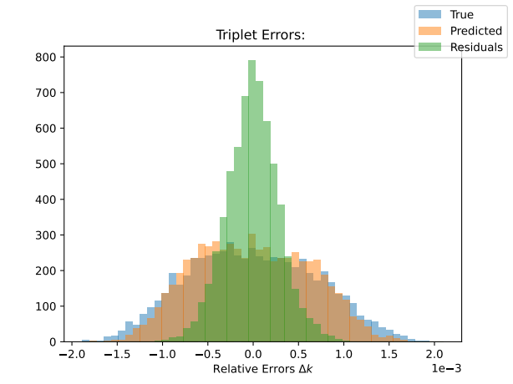
Backup slides: Results for 45CM
Triplet quadrupole performance is worse than in arc. Maybe the errors generated for 40CM in 2016 are too big for 30CM. Testing for 45 CM optics.
Train: R2 = 0.895 MAE = 3.118e-06
Test: R2 = 0.884 MAE = 3.292e-06
R2 Test 0.872 for 30CM
Similar results, hypothesis is wrong.
Fig 8. Quadrupole error histograms for 200 test samples

Slide 16
References
Fig 1. Data pipeline. "Supervised learning-based reconstruction of magnet errors in circular accelerators" by E. Fol, 2021, https://doi.org/10.1140/epjp/s13360-021-01348-5
Fig 2. Example Ridge regression. “Regularization Part 1: Ridge (L2) Regression" by J. Stamer, 2018, https://www.youtube.com/watch?v=Q81RR3yKn30

